Slide 1
Introduction to Digital Electronics

Slide 2
Lecture 1 Introduction to Digital Electronics
Lecture delivered by:
Deepak V.

Slide 3
Objectives
At the end of this lecture, student will be able to:
Describe Digital Electronics
Differentiate between Analog and Digital Signal

Slide 4
Topics
Introduction to Digital Electronics
Difference between Digital and Analog Electronics

Slide 5
Introduction to digital electronics
What is Digital Electronics
Digital Electronics is the branch of electronics which deals with the digital signals to perform various tasks and meet various requirements
It is based upon the digital design methodologies and consists of digital circuits, IC’s and logic gates
It uses only binary digits, i.e. either ‘0’ or ‘1’

Slide 6
Introduction to digital electronics
Need of Digital Electronics
Most analog systems were less accurate, and were slow in computation and performance
Digital system have the ability to work faster than analog equivalents, and can operate on very high frequencies too
It was much economical than analog methodologies as the performance was faster
Figure: Computer

Slide 7
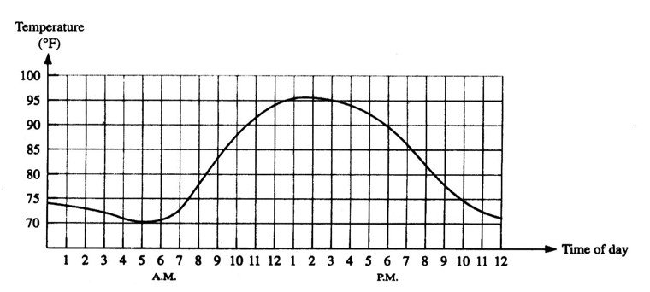
Introduction to digital electronics
Analog Quantities
Figure: Graph of Temperature Vs Time(Analog)

Slide 8
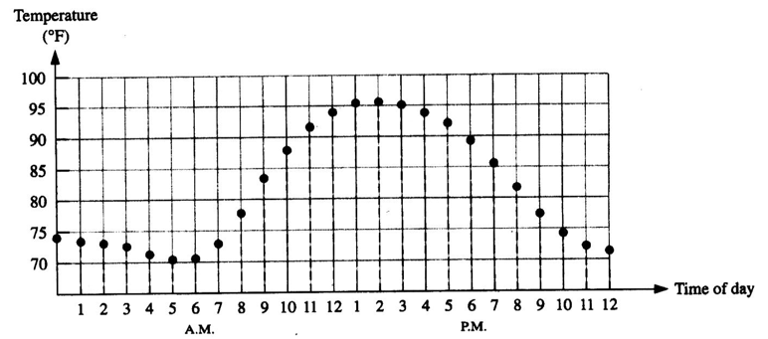
Introduction to digital electronics
Digital Quantities
Figure: Graph of Temperature Vs Time(Digital)
Digital systems can process, store, and transmit data more efficiently but can only assign discrete values to each point

Slide 9
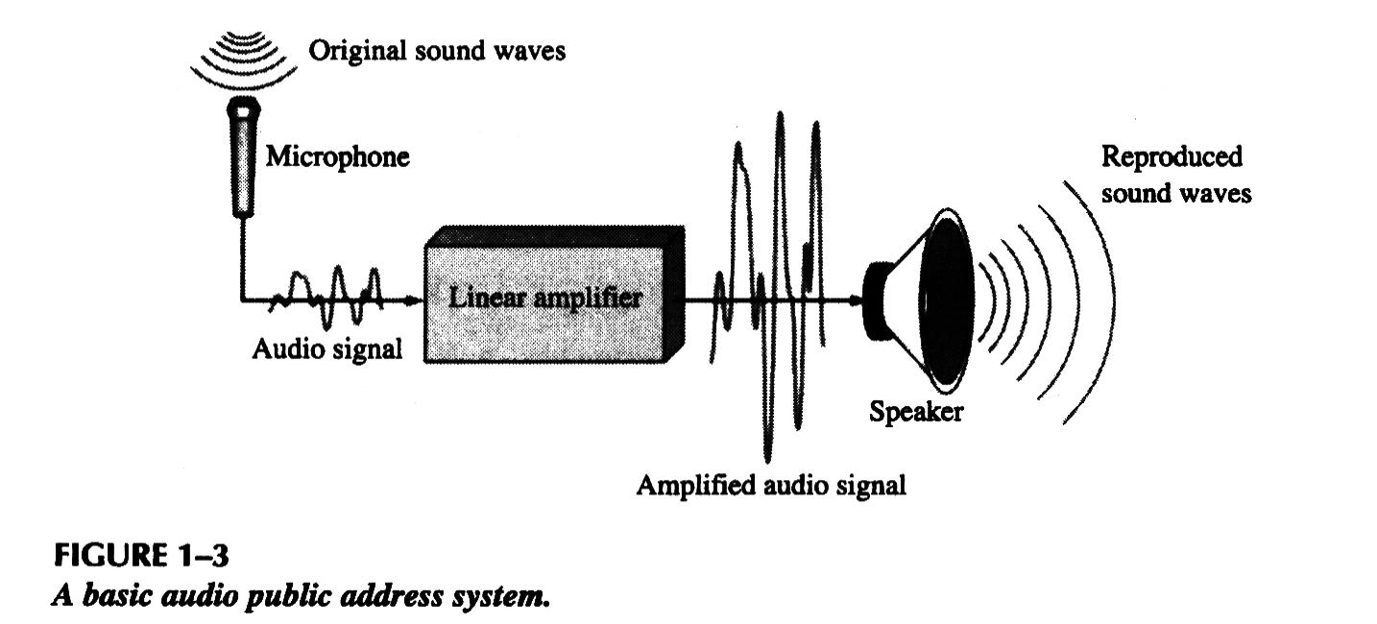
Analog Example
A public address system, used to amplify sound so that it can be heard by large audience, is one example of an application of analog electronics.
Figure: Basic audio public system

Slide 10
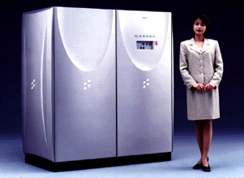
Digital Example
A computer system is one example of an application of digital electronics.
Figure: Computer

Slide 11
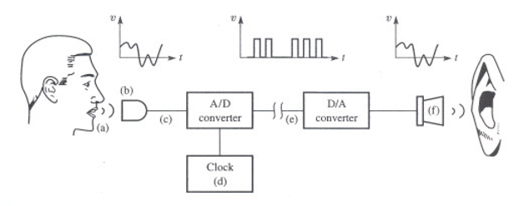
Digital Example
A digital telephone system

Slide 12
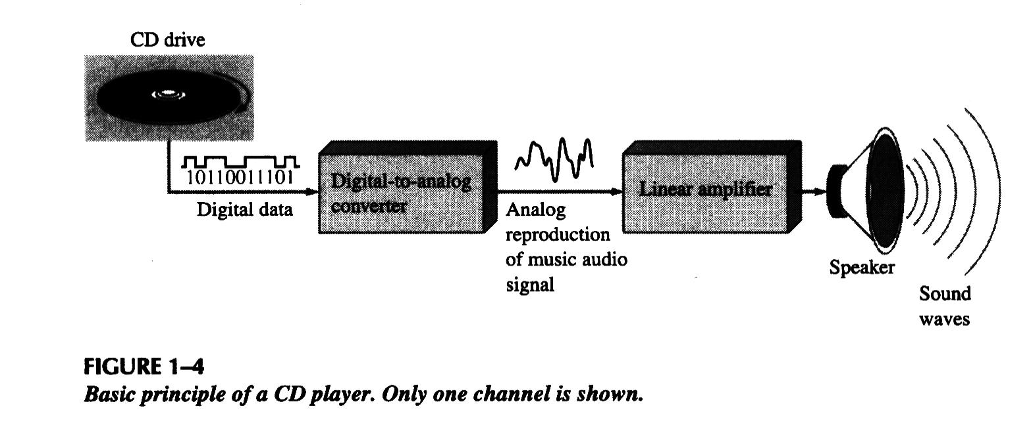
A Mixed System
The compact disk (CD) player is an example of a system in which both digital and analog circuits are used.

Slide 13
Analog Vs. Digital
Analog systems process time-varying signals that can take on any value across a continuous range of voltages (in electrical/electronics systems)
Digital systems process time-varying signals that can take on only one of two discrete values of voltages (in electrical/electronics systems).
Discrete values are called 1 and 0 (ON and OFF, HIGH and LOW, TRUE and FALSE, etc.)

Slide 14
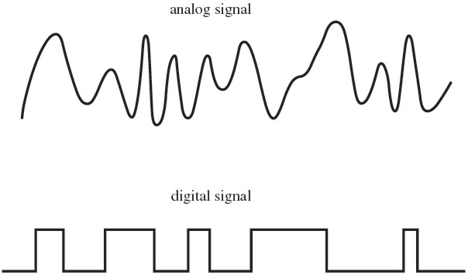
Representation of Analog and Digital
Figure: Analog and Digital signals

Slide 15
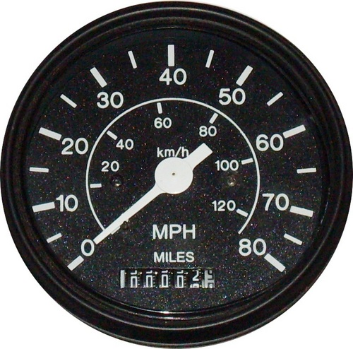
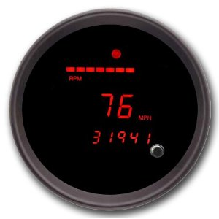
Example of Advantage of Digital Systems over Analog Systems
The most common present time example is the speedometers used in vehicles
In analog meters, there is an error chance of misreading the speed, while in the digital seven-segment display of a digital speedometer, there is no chances left for a misreading error, hence increasing the accuracy
Even in the digital meters, there is a ‘HOLD’ button to hold the display value on screen
Figure 1

Slide 16
Contd…
Analog Electronics
It has usually larger circuits & occupies more area
Analog measuring instruments are less accurate, chances of misreading are more
The instruments are delicate and harms are more in case of drops and falls
Digital Electronics
It has smaller integrated circuits & occupies lesser area
Digital measuring instruments are more accurate, and there is no case of misreading it
The instruments are more strong, and there are lesser harms on drops and falls

Slide 17
Digital Revolution
Digital systems started back in 1940s.
Digital systems cover all areas of life:
Still pictures
Digital video
Digital audio
Telephone
Traffic lights
Animation

Slide 18
Summary
Digital Electronics deals with the digital signals to perform various tasks and meet various requirements
It uses only binary digits, i.e. either ‘0’ or ‘1’
Digital system have the ability to work faster than analog equivalents, and can operate on very high frequencies too
Digital systems can process, store, and transmit data more efficiently but can only assign discrete values to each point
Analog systems process time-varying signals that can take on any value across a continuous range of voltages.

